Slide 1

Fundamentals of 3D Computer Vision
Course lecturer: Prof. Shohreh Kasaei
Group 3
Ahmadreza Khanari - Amir Hosein Haji Mohammad Rezai - Ramtin Moslemi
Fall of 2023 - Winter of 2024

Slide 2
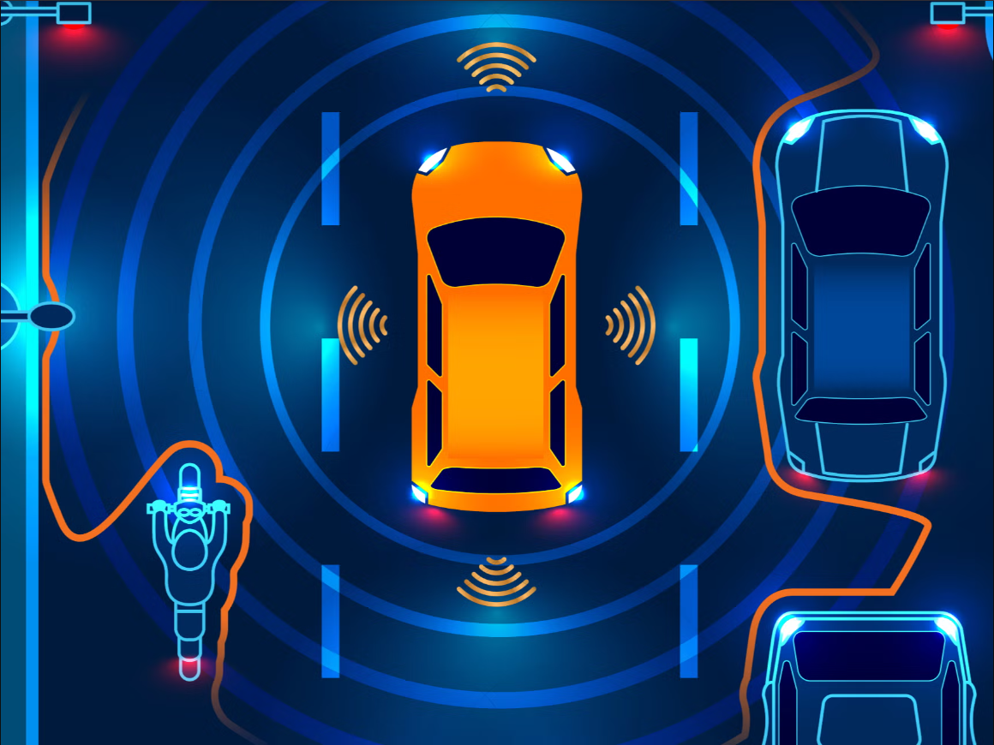
3D depth map for the application of
Autonomous Vehicles

Slide 3
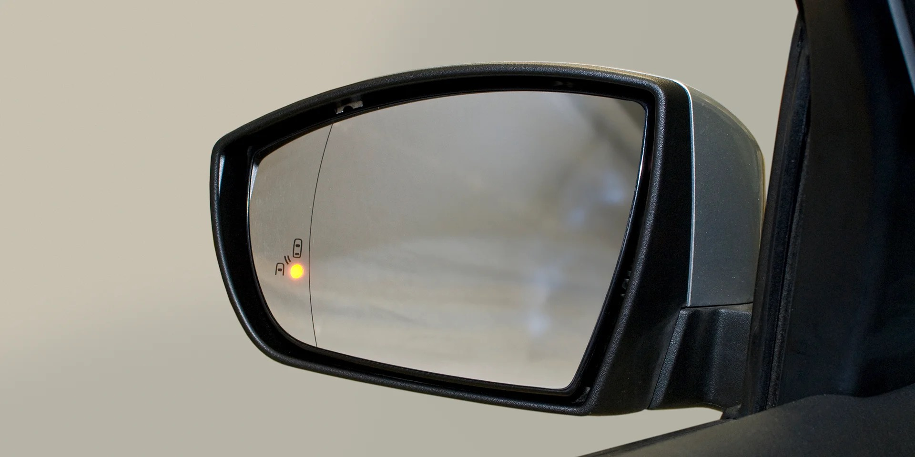
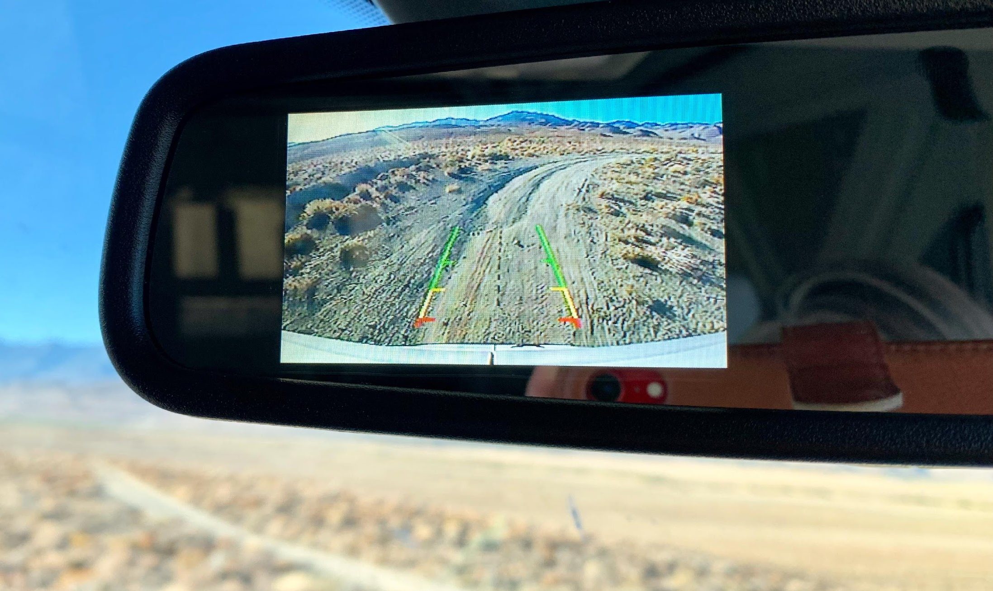
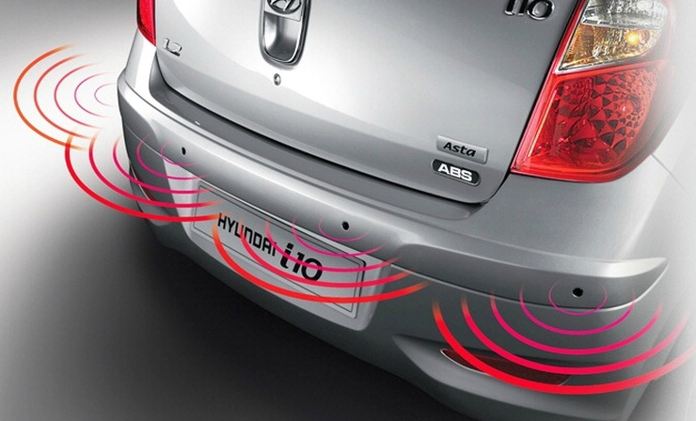
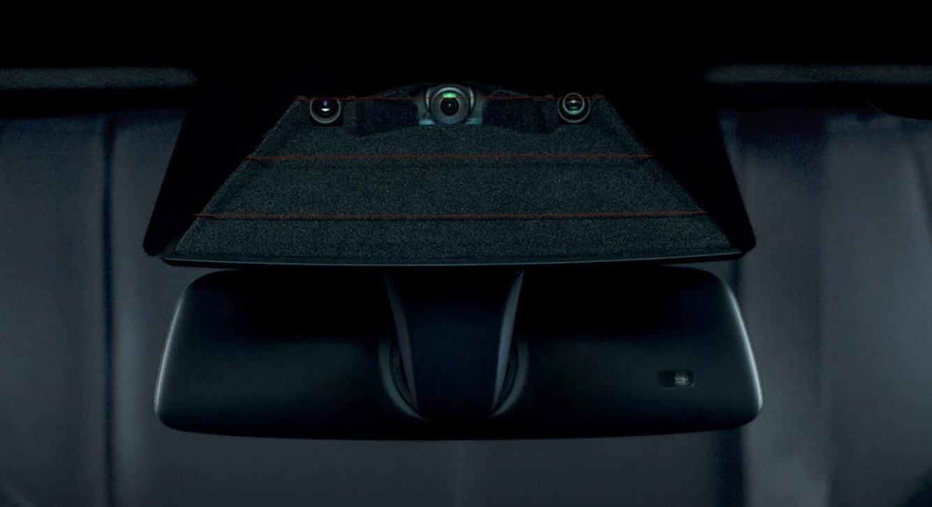
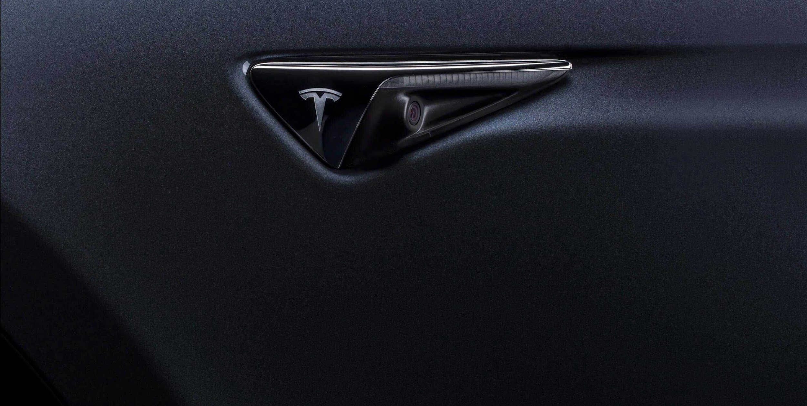
Cameras and Sensors in Cars
Blind spot assist [image source]
Parking Sensors [image source]
Backup camera [image source]
Front camera [image source]
Side camera [image source]

Slide 4
Computer Vision Systems
Autonomous Vehicles vs. Human Drivers
Absolutely essential for autonomous vehicles:
Environmental Perception
Obstacle Detection and Avoidance
Lane Detection and Localization
Traffic Sign Recognition
Also very beneficial for human drivers:
Driver Assistance Systems
Blind Spot Detection
Parking Assistance
Traffic Sign Recognition
Pedestrian and Cyclist Detection
Object Detection and Classification
Adaptive Cruise Control and Collision Avoidance
Pedestrian and Cyclist Detection
Driver Monitoring
Enhanced Navigation

Slide 5
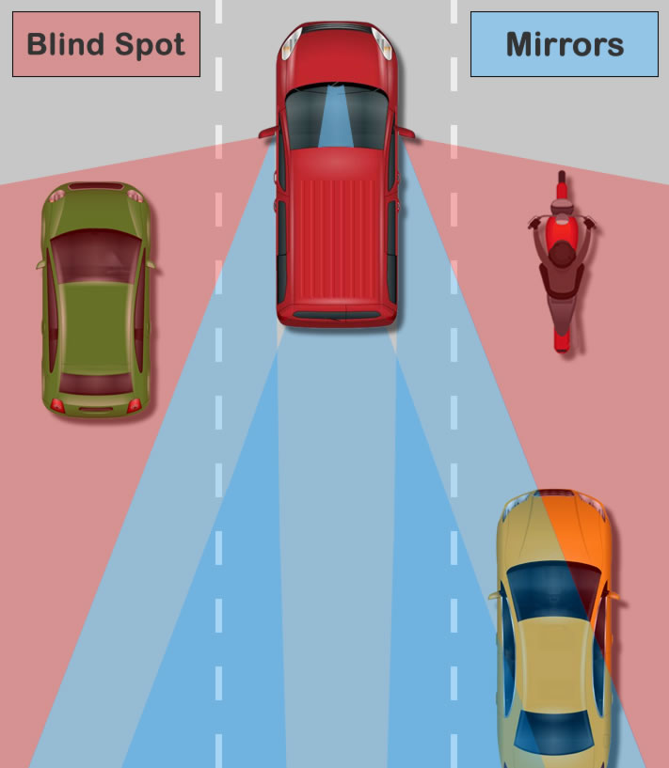
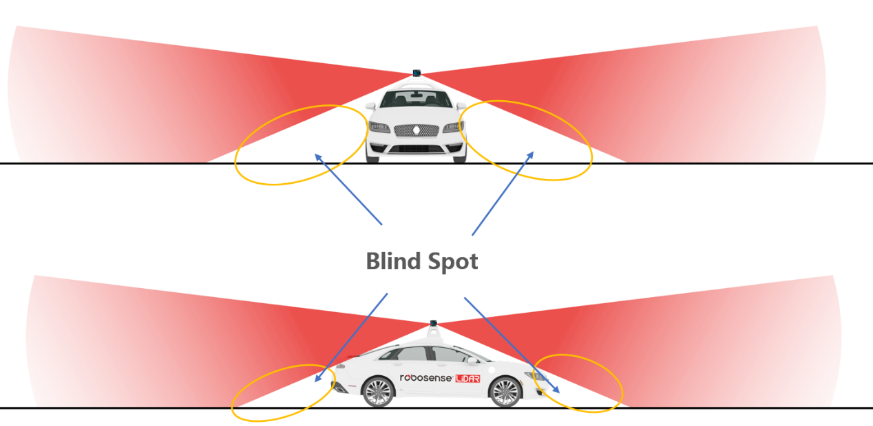
Blind Spots
Blind spots for humans and sensors [image source]
Blind spots for humans [image source]

Slide 6
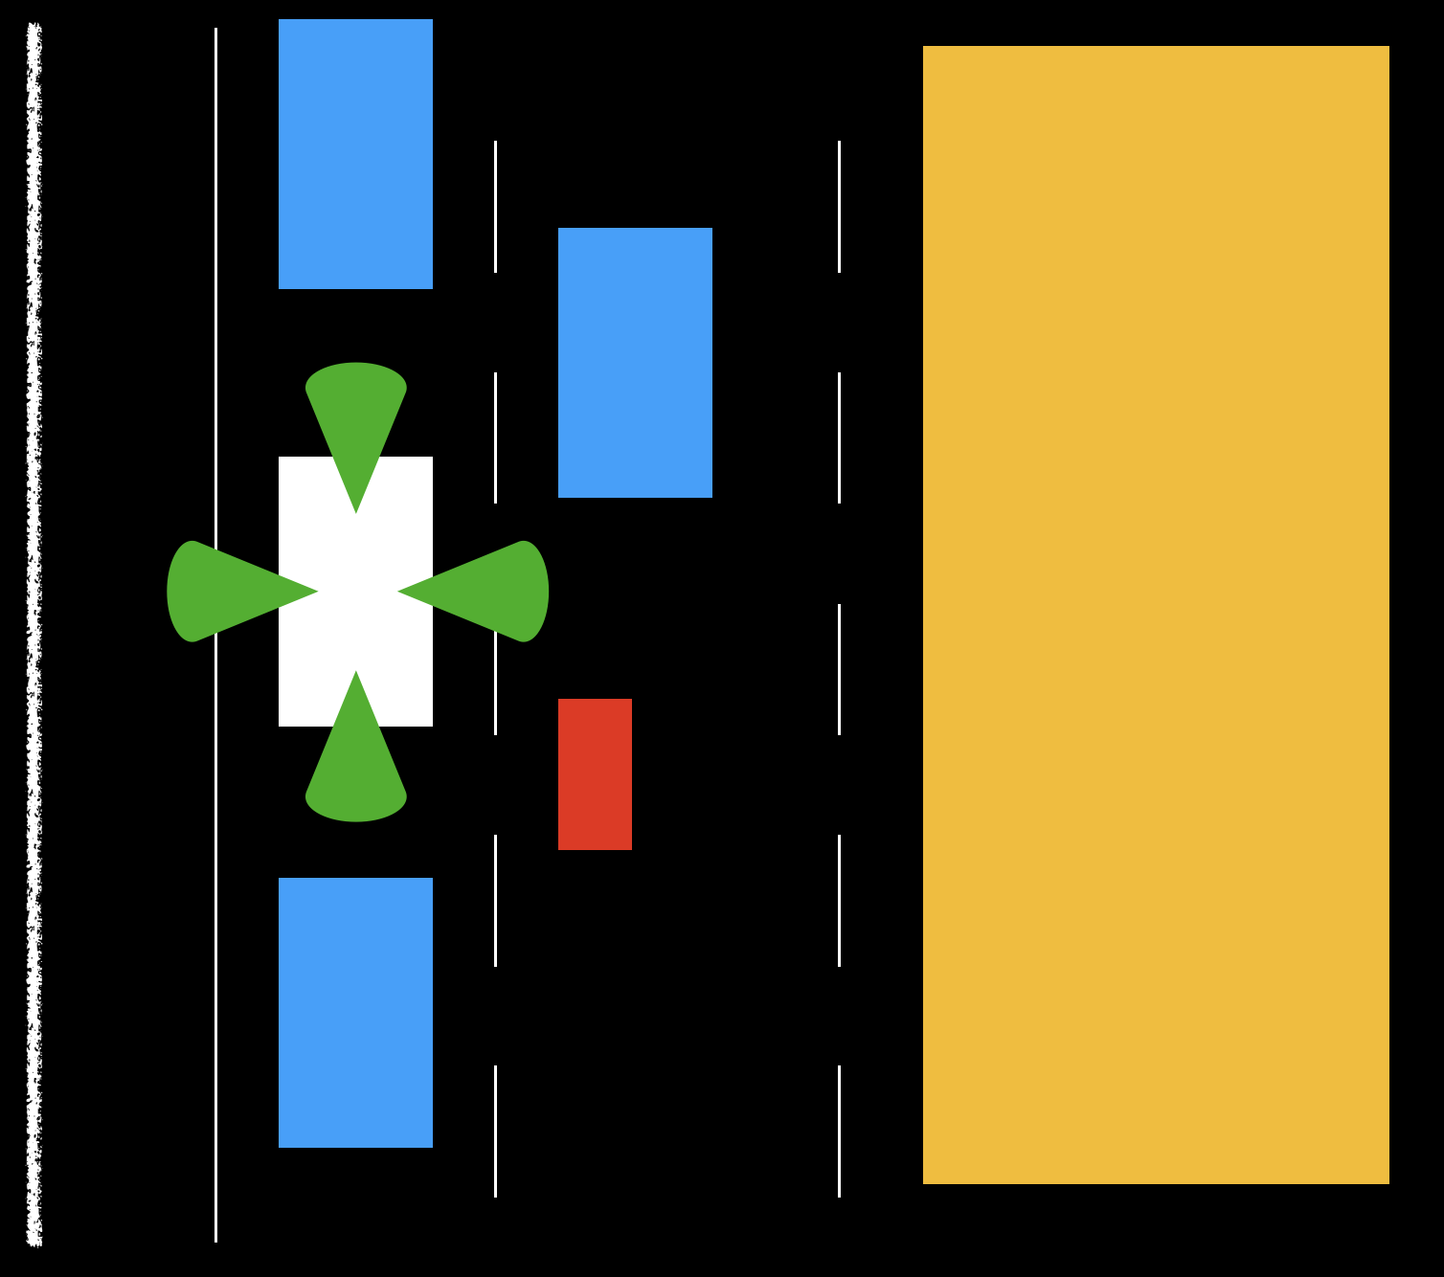
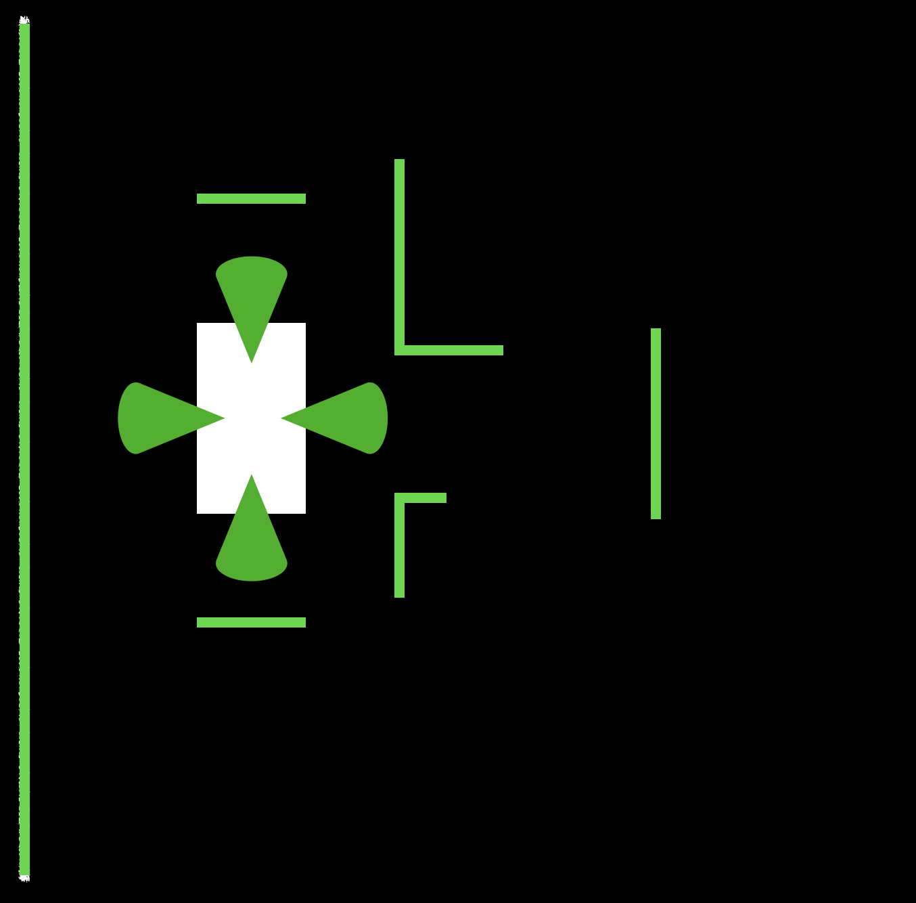

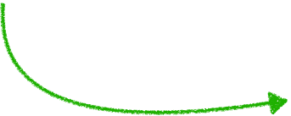

First Sketches
The Idea!
Reconstruct Scene
Use Sensors
Recover Depth

Slide 7
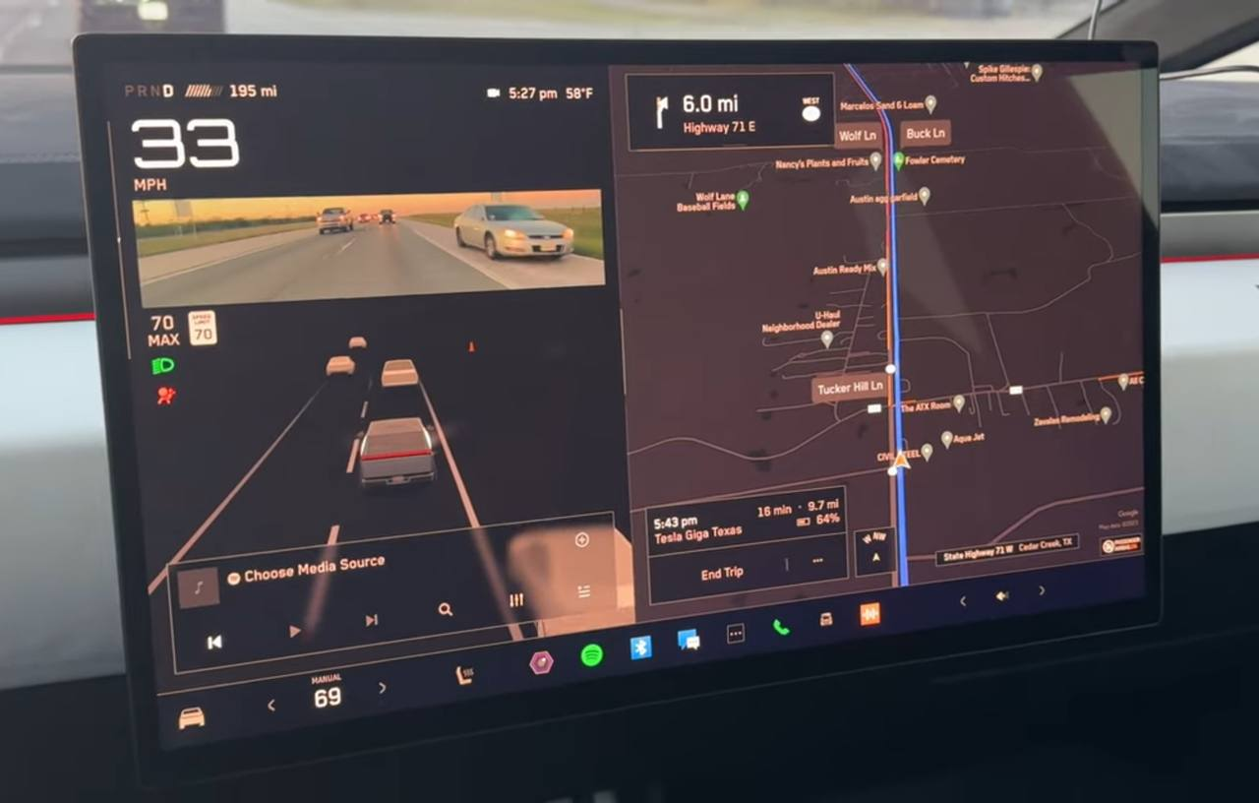
Implementation Example
Tesla Cybertruck [image source]

Slide 8
Datasets

Slide 9
Challenges
Unless special lenses are used, the field of view (FoV) of a camera is often limited to around 30-40 degrees. (We need many cameras)
Datasets are often quite large and loading them could become a challenge. (We can use cloud-based solutions)
Depth recovery from monocular images needs a combination of structure from motion and stereo disparity. (We can use deep learning methods or radars to recover depth)
In order to detect and classify objects we need labeled data.

Slide 10
The nuScenes Dataset
Overview
The nuScenes dataset is a public large-scale dataset for autonomous driving developed by the team at Motional.
Consists of 1000 driving scenes in Boston and Singapore, two cities that are known for their dense traffic and highly challenging driving situations.
The scenes of 20 second length are manually selected to show a diverse and interesting set of driving maneuvers, traffic situations and unexpected behaviors.
The nuScenes dataset is available as a free to use for non-commercial purposes.

Slide 11
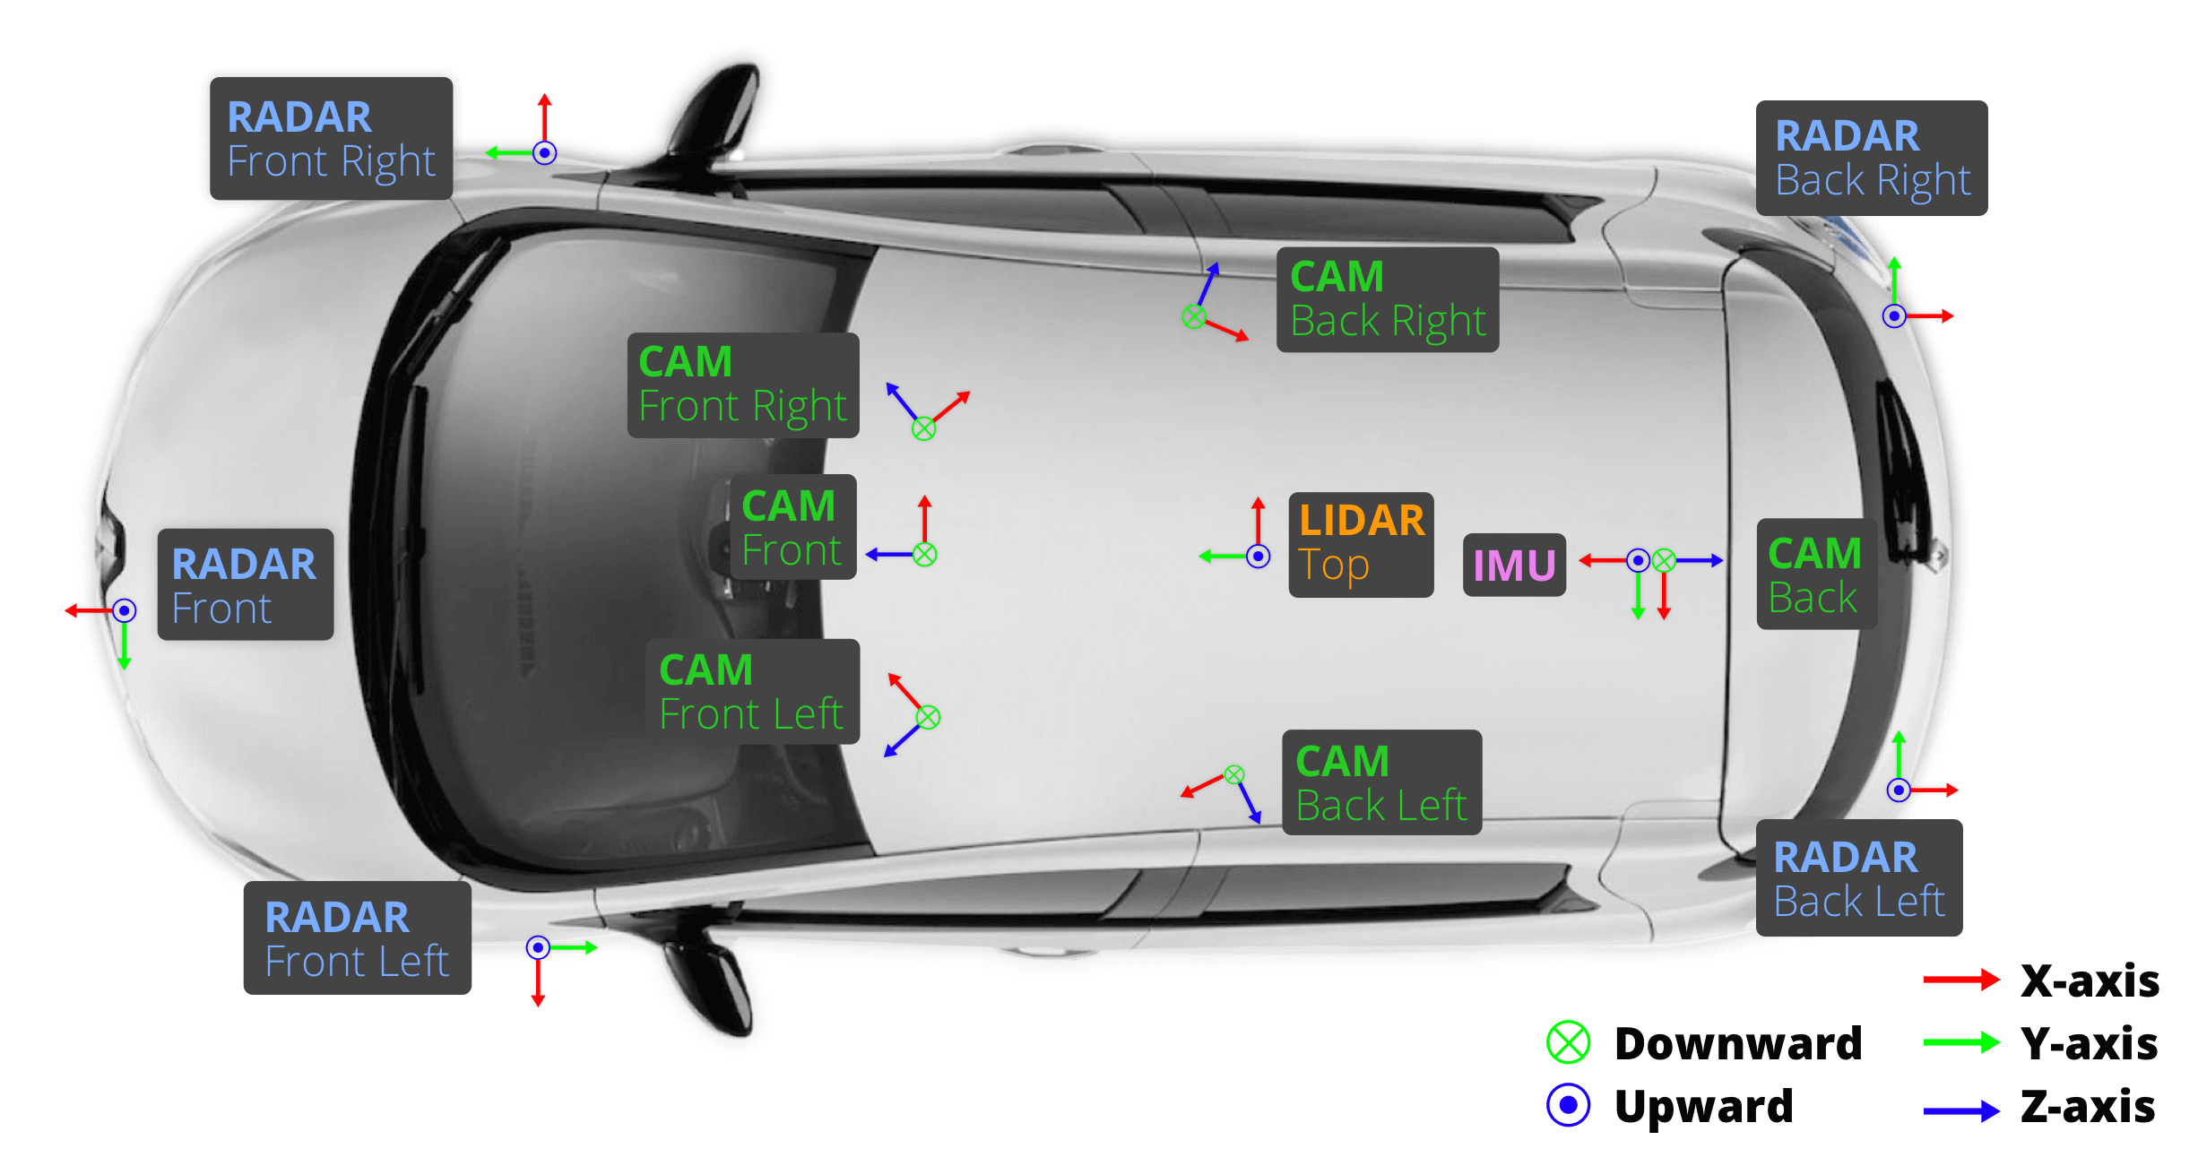
The nuScenes Dataset
Car Setup
Placement of sensors and cameras in the nuScenes dataset [image source]

Slide 12
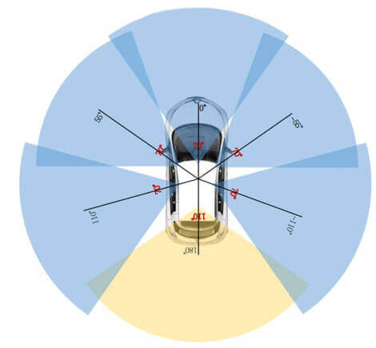
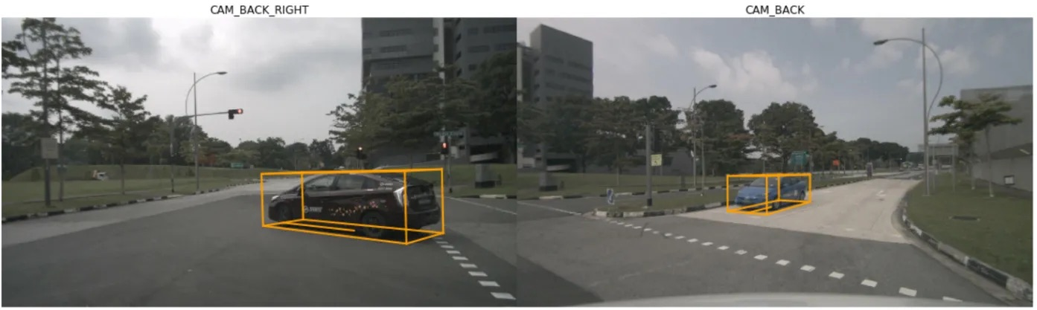
The nuScenes Dataset
Data Annotation
All objects come with a semantic category, as well as a 3D bounding box and attributes for each frame they occur in.
Compared to 2D bounding boxes, this allows us to accurately infer an object’s position and orientation in space.
FoV of cameras in the nuScenes dataset [image source]

Slide 13
Image Stitching

Slide 14
Challenges
We don’t have the exact internal and external characteristics of the cameras used. (We need to estimate the homography matrix)
Finding good features to match could be difficult because:
The surrounding environment doesn’t provide good features
There isn’t much overlap in images to recover matching points
We need to improve our methods to obtain decent results!

Slide 15
Our Algorithm
Initialize H, cnt=0.
for i in range(len(frames)):
img1, img2 = frames[i]
H’ = estimate_homography(img1, img2)
if ||H - H’|| < Threshold:
cnt = cnt + 1
ɑ = 1 / cnt
H = ɑ H’ + (1-ɑ) H
result = stitch_images(img1, img2, H)
To slow?
Reduce homography estimation frequency.
Homography matrix drifts overtime?
Use Exponentially Weighted Moving Average (EWMA)

Slide 16
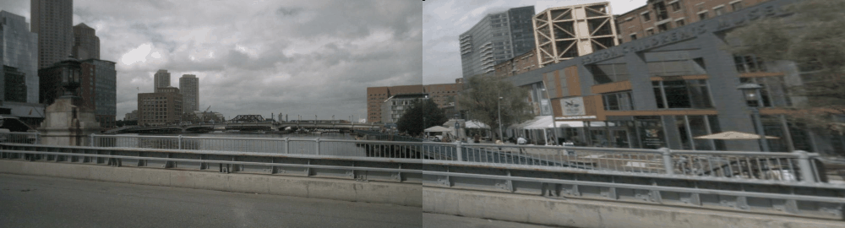
Results
Image stitching on the front and back cameras of the left side

Slide 17
Depth Recovery

Slide 18
Challenges
Training a deep neural network on this dataset requires immense resources and time!
In this section we will only provide an overview of the methods used for achieving state of the art results.
We will learn about the general architectures and ideas used.

Slide 19
Inputs of the Model
LiDAR Input:
The LiDAR sensor data is represented as a point cloud, which consists of 3D coordinates (x, y, z) of points in the environment, along with additional attributes such as intensity or reflectance values. This point cloud data provides geometric information about the scene, including the positions and shapes of objects.
Camera Input:
The camera sensor data consists of images captured from one or more cameras mounted on the vehicle. These images provide visual information about the scene, including colors, textures, shapes, and contextual information.

Slide 20
Outputs of the Model
Bounding Box:
The 3D bounding box coordinates (x, y, z) along with dimensions (length, width, height) of the detected object.
Object Category:
The class label or category of the detected object (e.g., car, pedestrian, cyclist, truck, etc).
Confidence Score:
The confidence or probability score indicating the likelihood that the predicted bounding box accurately represents an object of the specified category.

Slide 21
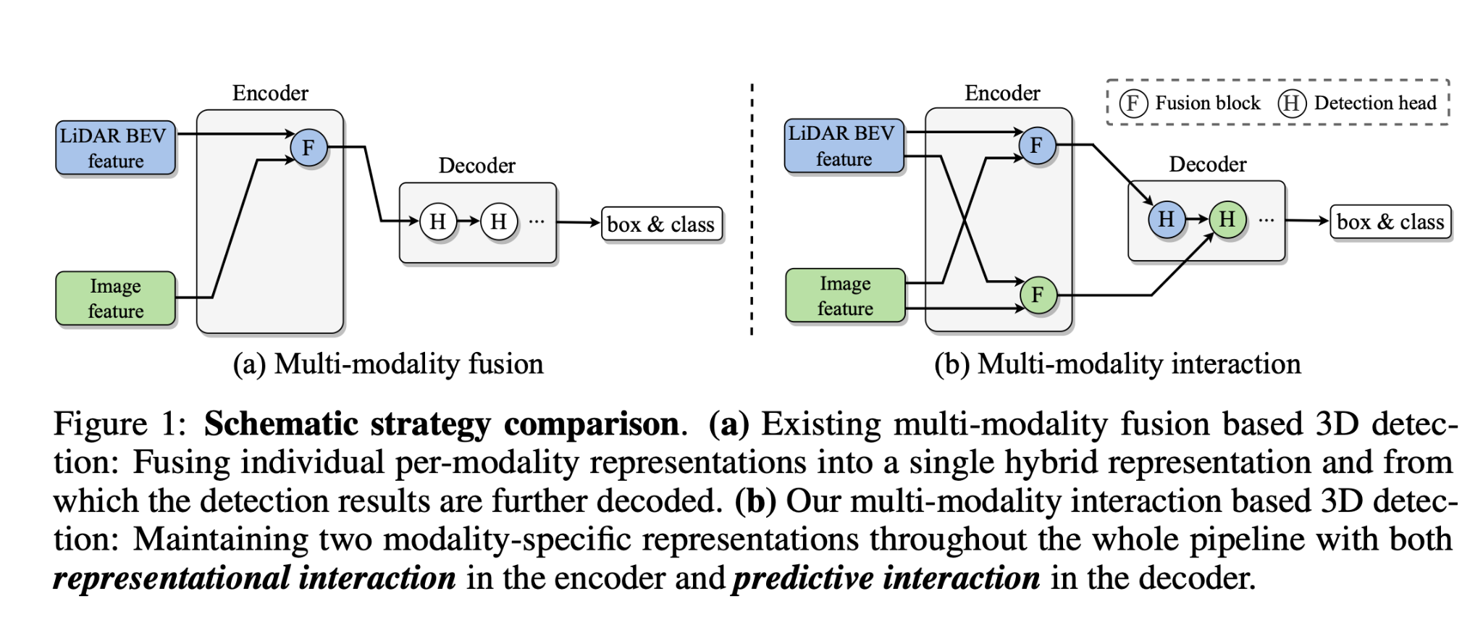
DeepInteraction: 3D Object Detection via Modality Interaction

Slide 22
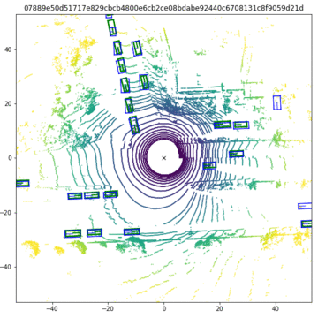
Output Example

Slide 23
Summary

Slide 24
Advantages
Easier than autonomous vehicles
Intermediary step for fully autonomous vehicles
Collecting more data for training
Useful for human drivers as well

Slide 25
Future Works
Better models with higher accuracy!
Interactive cylindrical backprojection for 360 view
Rotating stitched image center to give driver the most important view
Better and bigger datasets with more cameras
Using deep learning methods for image stitching
Using deep learning to improve image quality in dark environments

Slide 26
References
Brown, Matthew, and David G. Lowe. "Automatic panoramic image stitching using invariant features." International journal of computer vision 74 (2007): 59-73.‏
OpenAI. (2024). ChatGPT (Feb 7 version) [Large language model]. https://chat.openai.com/chat
Yang, Zeyu, et al. "Deepinteraction: 3d object detection via modality interaction." Advances in Neural Information Processing Systems 35 (2022): 1992-2005.‏
Caesar, Holger, et al. "nuscenes: A multimodal dataset for autonomous driving." Proceedings of the IEEE/CVF conference on computer vision and pattern recognition. 2020.‏
Dosovitskiy, Alexey, et al. "CARLA: An open urban driving simulator." Conference on robot learning. PMLR, 2017.‏
Kumar, Varun Ravi, et al. "Monocular fisheye camera depth estimation using sparse lidar supervision." 2018 21st International Conference on Intelligent Transportation Systems (ITSC). IEEE, 2018.
Godard, Clément, et al. "Digging into self-supervised monocular depth estimation." Proceedings of the IEEE/CVF international conference on computer vision. 2019.‏

